Slide 1
Lesson 3.8
Places of Refuge and
Salvage Considerations
CGPRT(W) : Ensuring Clean Seas and Coasts in Western Region ……

Slide 2
Objective
To understand the powers of intervention.
To consider the role of the Administration in respect of maritime casualties.
To be able to identify and designate potential Places of Refuge.
To understand the risk assessment process for determining Places of Refuge.
CGPRT(W) : Ensuring Clean Seas and Coasts in Western Region ……

Slide 3
Requirement for Assistance
Fire and/or explosion
Damage to the ship
  Mechanical or structural
Collision
Grounding
Storm or ice damage
Flooding
Sabotage
Terrorism or piracy
CGPRT(W) : Ensuring Clean Seas and Coasts in Western Region ……

Slide 4
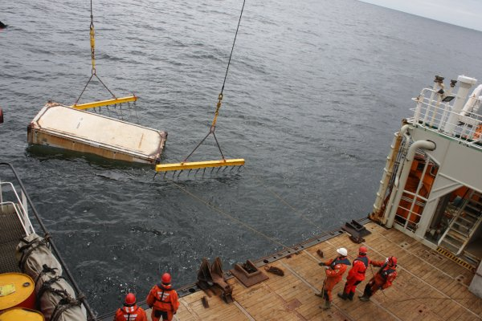
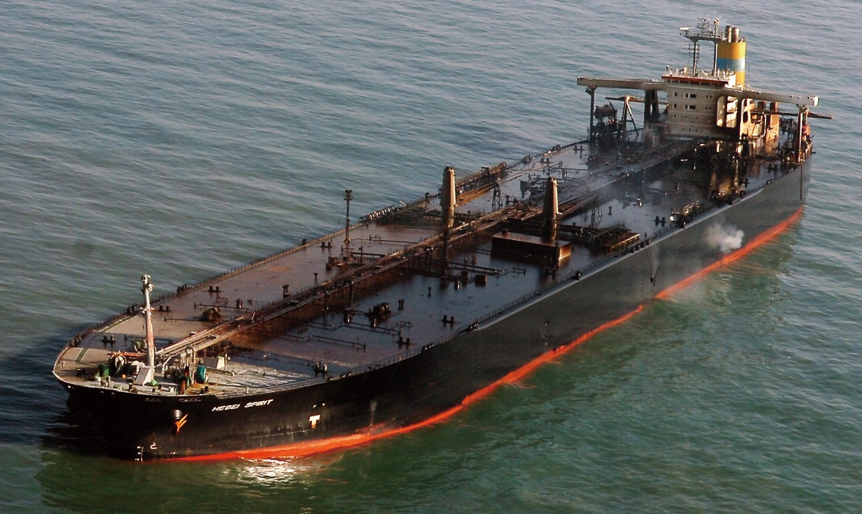
Requirement for Assistance
CGPRT(W) : Ensuring Clean Seas and Coasts in Western Region ……

Slide 5
Initial Response
The Master of the vessel should take immediate action to ensure:
The safety of the crew and passengers
The preservation of the ship
Attempt to stop or limit cargo or bunker outflow
The Master may require specialist advice on stability, damage control and salvage.
CGPRT(W) : Ensuring Clean Seas and Coasts in Western Region ……

Slide 6
Salvor’s Objectives
The Master, shipowner or manager engages salvors under a commercial agreement.
The salvor’s objective is to:
Salve the ship and cargo
Remove them to a place of safety
To avoid, or minimize, any damage to the environment
This requires cooperation between salvor, coastal State, shipowners, cargo interests, property and liability insurers.
CGPRT(W) : Ensuring Clean Seas and Coasts in Western Region ……

Slide 7
Powers of Intervention
International Convention relating to Intervention of the High Seas in cases of Oil Pollution Casualties, 1969 (INTERVENTION).
Entered into force in May 1975.
Protocol adopted to extend the Convention to cover substances other than oil.
CGPRT(W) : Ensuring Clean Seas and Coasts in Western Region ……

Slide 8
Powers of Intervention
Affirms the right of a coastal State to take such measures on the high seas as may be necessary to prevent, mitigate or eliminate danger to its coastline or related interests from pollution by oil or the threat thereof, following a marine casualty.
The coastal state should ensure that measures are proportionate to the actual or threatened damage.
CGPRT(W) : Ensuring Clean Seas and Coasts in Western Region ……

Slide 9
The Role of the Coastal State
A coastal State should have the following:
A contingency plan
A system of receiving, assessing and evaluating incident reports
A system for the identification of hazards and assessment of associated risks
A clear command and control system with decision-making capabilities
An understanding of the environmental, economic and social factors at risk
CGPRT(W) : Ensuring Clean Seas and Coasts in Western Region ……

Slide 10
Assessment of Risks
Natural conditions
  Prevailing winds
  Weather and sea conditions
  Bathymetry (underwater topography)
  Seasonal effects
Vessel condition
  Navigational characteristics
  Operational condition
  Cargo
  Bunkers
CGPRT(W) : Ensuring Clean Seas and Coasts in Western Region ……

Slide 11
Assessment of Risks
Environmental and social factors
  Safety
    Crew, passengers or public
  Pollution
  Designated environmental areas
  Sensitive habitats and species
  Fisheries
  Economic/industrial facilities
  Amenity resources and tourism
  Facilities available
CGPRT(W) : Ensuring Clean Seas and Coasts in Western Region ……

Slide 12
Assessment of Risks
Contingency planning
  Competent Maritime Assistance Service (MAS)
  Roles and responsibilities of authorities and responders
    Salvage, fire fighting and cargo transfer capability
  Response equipment needs and availability
  Evacuation facilities
Foreseeable consequences
CGPRT(W) : Ensuring Clean Seas and Coasts in Western Region ……

Slide 13
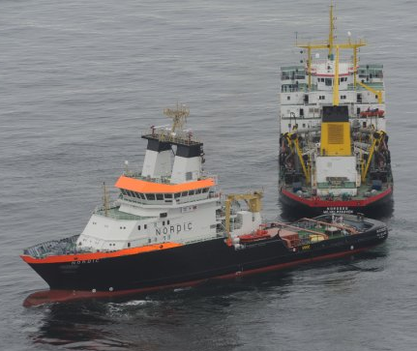
Emergency Response
Emergency response and follow-up actions:
  Lightering
    Cargo or bunker transfer
  Towage
    Shelter or re-floating
  Salvage
    Re-floating or wreck removal
  Pollution combating
  Protection of local population
CGPRT(W) : Ensuring Clean Seas and Coasts in Western Region ……

Slide 14
Response
Is intervention at sea the best option?
Balance the opportunity to prevent the oil
leaving the vessel against the possible consequences
Risk to human health and safety
Damage to vessel and cargo
Damage to the environment
Administrations are urged not to unreasonably deny access to sheltered waters.
CGPRT(W) : Ensuring Clean Seas and Coasts in Western Region ……

Slide 15
Response
Is it possible?
If intervention as sea is desirable:
Can it be done?
Is the expertise available?
Is the equipment available?
Your contingency planning should address these questions.
CGPRT(W) : Ensuring Clean Seas and Coasts in Western Region ……

Slide 16
Response – Evaluation
Place an evaluation team on board:
Experienced personnel equipped with appropriate personal protective equipment
Ascertain full status of the vessel
    cargo, bunkers and disposition
    equipment and facilities on board
    operational status of machinery, etc.
Carry out risk assessment
CGPRT(W) : Ensuring Clean Seas and Coasts in Western Region ……

Slide 17
IMO Resolutions
IMO Assembly
  Twenty-third session, March 2004
Resolution A.949
  Guidelines on places of refuge for ships in need of assistance
Resolution A.950
  Guidelines on the establishment of a Maritime Assistance Service (MAS)
CGPRT(W) : Ensuring Clean Seas and Coasts in Western Region ……

Slide 18
Definitions
Ship in need of assistance
a ship in a situation, apart from one requiring rescue of persons on board, that could give rise to loss of the vessel or an environmental or navigational hazard
Place of Refuge
a place where a ship in need of assistance can take action to enable it to stabilize its condition and reduce the hazards to navigation and to protect human life and the environment
Maritime Assistance Services (MAS)
a point of contact between ship and coastal State
CGPRT(W) : Ensuring Clean Seas and Coasts in Western Region ……

Slide 19
Place of Refuge Considerations
Identity of the authority responsible for handling and receiving alerts
Identity of the competent authority who will
  assess the situation
  take the decision to accept or refuse
Information on the coastline, environmental, economic, social factors and natural conditions
CGPRT(W) : Ensuring Clean Seas and Coasts in Western Region ……

Slide 20
Place of Refuge Considerations
The assessment process
Likelihood/Consequence matrix
Risk register
The resources and expertise available
Procedures for decision-making
Procedures for international coordination
Financial guarantee and liability procedures
CGPRT(W) : Ensuring Clean Seas and Coasts in Western Region ……

Slide 21
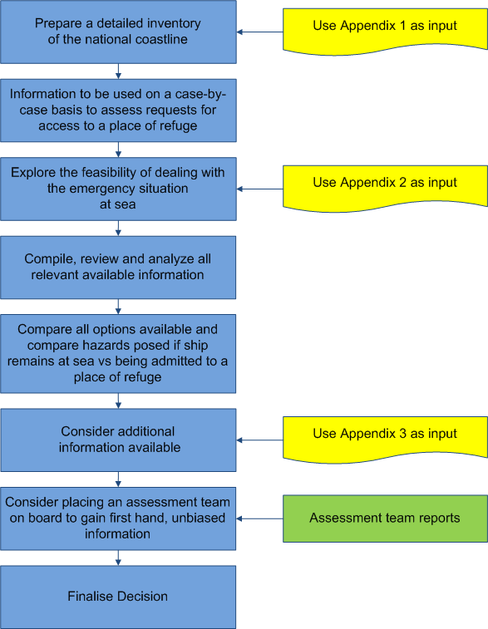
Place of Refuge
Decision-making process
Source: REMPEC SAFEMED Project 2005/109-573
CGPRT(W) : Ensuring Clean Seas and Coasts in Western Region ……

Slide 22
Likelihood/Consequence Matrix Example
Likelihood | Consequence
 | Insignificant | Minor | Moderate | Major | Catastrophic
Almost certain (> 90% chance) | High | High | Extreme | Extreme | Extreme
Likely (50% ~ 90% chance) | Moderate | High | High | Extreme | Extreme
Moderate (10% ~ 50% chance) | Low | Moderate | High | Extreme | Extreme
Unlikely (3% ~ 10% chance) | Low | Low | Moderate | High | Extreme
Rare (< 3% chance) | Low | Low | Moderate | High | High
CGPRT(W) : Ensuring Clean Seas and Coasts in Western Region ……

Slide 23
Risk Register − Example
ID | Risk | Consequence | Consequence
 |  | Remain in situ | Place of Refuge
1 | Crew Safety | High | Low
2 | Responder/Salvor Safety | High | Low
3 | Public Safety | Low | Medium
4 | Pollution – Cargo | High | Low
5 | Pollution - Bunkers | High | Medium
6 | Navigational Safety | Low | Low
7 | ………………..
8 | ………………..
CGPRT(W) : Ensuring Clean Seas and Coasts in Western Region ……

Slide 24
Other Actions
In addition to the emergency response actions some consideration has to be given to the investigation of the initial accident.
IMO Code of International Standards and Recommended Practices for a Safety Investigation into a Marine Casualty or Marine Accident
  Parts I and II are mandatory (SOLAS chapter XI-1)
CGPRT(W) : Ensuring Clean Seas and Coasts in Western Region ……

Slide 25
Summary
We have considered:
the powers of intervention
the role of the Administration in respect of maritime casualties
how to identify and designate potential Places of Refuge
To understand the risk assessment process for determining Places of Refuge.
CGPRT(W) : Ensuring Clean Seas and Coasts in Western Region ……

Slide 26
Any questions?
CGPRT(W) : Ensuring Clean Seas and Coasts in Western Region ……

